Slide 1
Electro Magnetic Induction
Dr Kapil Garg
Dept. Of Musculoskeletal Physiotherapy
MGM Institute Of Physiotherapy
Chh. Sambhajinagar

Slide 2
Introduction
Electromagnetic or magnetic induction is the production of an electromotive force (emf) across an electrical conductor in a changing magnetic field.
Electromagnetic induction has found many applications, including electrical components such as inductors and transformers, and devices such as electric motors and generators.

Slide 3
Electromagnetic Induction is the process of using magnetic fields to produce voltage, and in a complete circuit, a current.
Michael Faraday first discovered it, using some of the works of Hans Christian Oersted. His work started at first using different combinations of wires and magnetic strengths and currents, but it wasn't until he tried moving the wires that he got any success

Slide 4
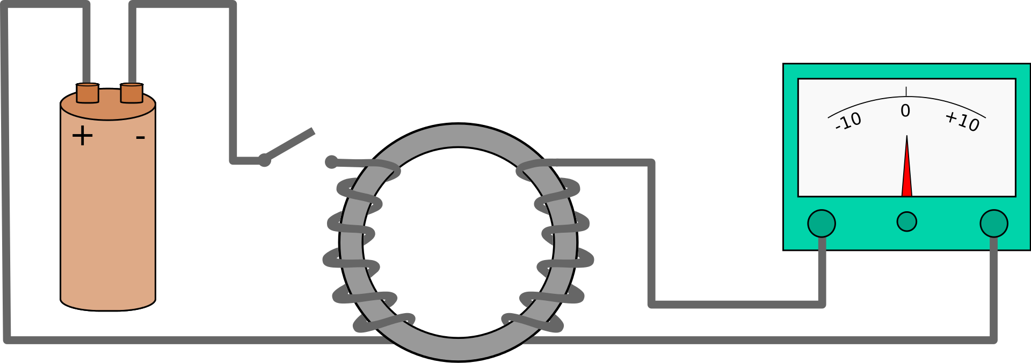
Electromagnetic Induction
Almost 200 years ago, Faraday looked for evidence that a magnetic field would induce an electric current with this apparatus

Slide 5
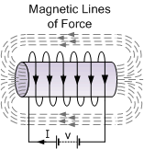

Slide 6
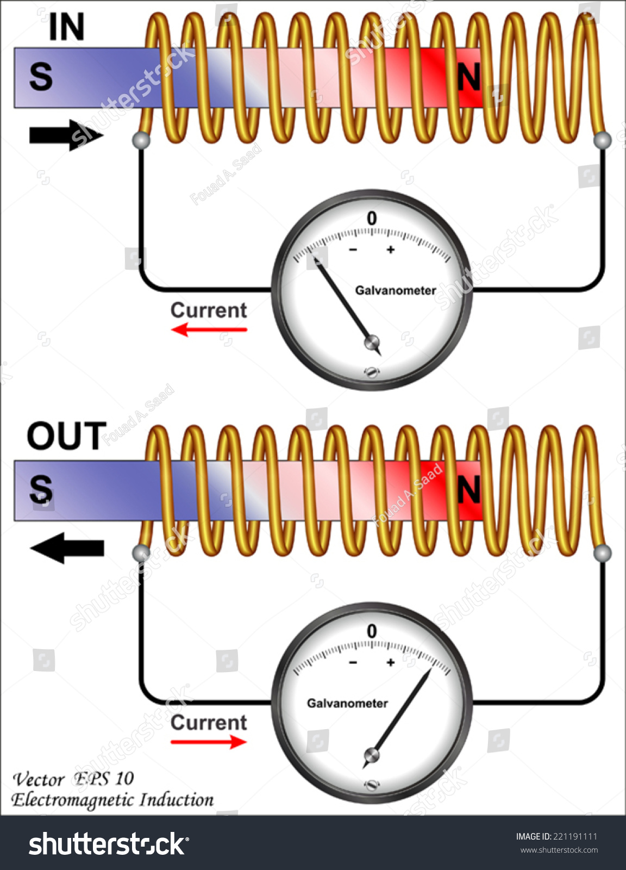
He found no evidence when the magnet was steady, but did see a current induced when the magnet moves up and down .

Slide 7
Magnetic Flux:
Magnetic flux is the quantity of magnetic field that penetrates an area at right angles to it.
Flux is a general term associated with a field that is bound by a certain area
So Magnetic Flux is any area that has a Magnetic Field passing through it.

Slide 8
We generally define an area vector as one that is perpendicular to the surface of the material.
Therefore, you can see in the figure that the area vector and the Magnetic Field vector are parallel.
This produces a dot product between the 2 variables that then define flux.

Slide 9
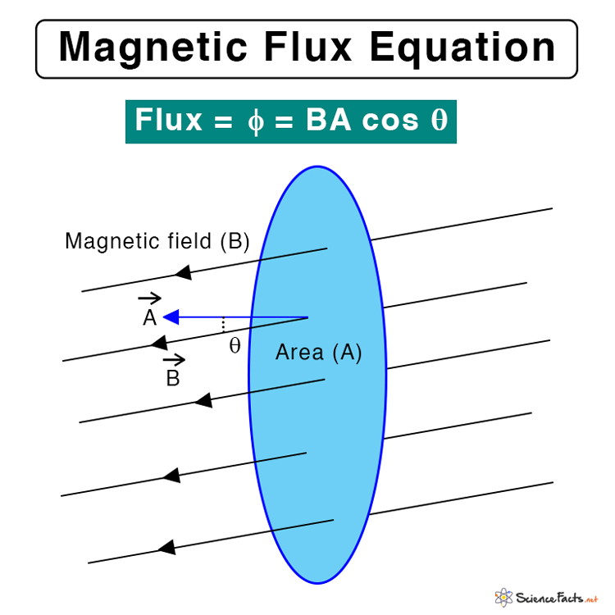

Slide 10
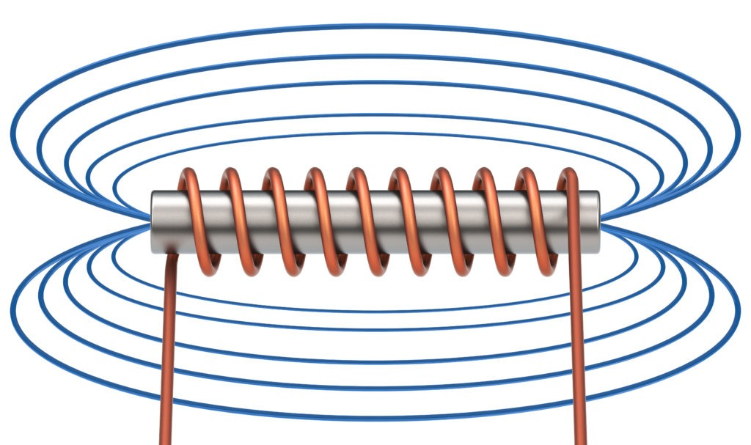
Electro magnetic field

Slide 11
Electromagnetic Induction Faraday’s Law
Faraday’s law of electromagnetic induction, also known as Faraday’s law, is the basic law of electromagnetism which helps us predict how a magnetic field would interact with an electric circuit to produce an electromotive force (EMF). This phenomenon is known as electromagnetic induction.

Slide 12
Michael Faraday proposed the laws of electromagnetic induction in the year 1831. Faraday’s law or the law of electromagnetic induction is the observation or results of the experiments conducted by Faraday. He performed three main experiments (LAWS) to discover the phenomenon of electromagnetic induction.

Slide 13
1. Faraday’s Law of Electromagnetic Induction
    Faraday’s First Law of Electromagnetic Induction
    Faraday’s Second Law of Electromagnetic Induction
Lenz’s Law
Faraday’s Law Derivation

Slide 14
Faraday’s First Law of Electromagnetic Induction
The first law describes the induction of emf in a conductor
Whenever a conductor is placed in a varying magnetic field, an electromotive force is induced. If the conductor circuit is closed, a current is induced, which is called induced current

Slide 15
Ways to change the magnetic field intensity in a closed loop
By rotating the coil relative to the magnet.
By moving the coil into or out of the magnetic field.
By changing the area of a coil placed in the magnetic field.
By moving a magnet towards or away from the coil.

Slide 16
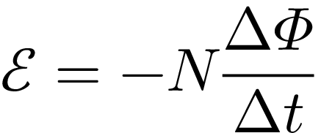
Faraday’s Second Law of Electromagnetic Induction
The induced emf in a coil is equal to the rate of change of flux linkage
The flux linkage is the product of the number of turns in the coil and the flux associated with the coil. The formula of Faraday’s law is given below

Slide 17
Lenz’s Law
The direction of the emf and thus the current is given by Lenz’s law.
Use this to find the direction of the current.
If you are looking down on the loop from above, is the current flowing clockwise or counter clockwise?
It is the most convenient method to determine the direction of the induced current.

Slide 18
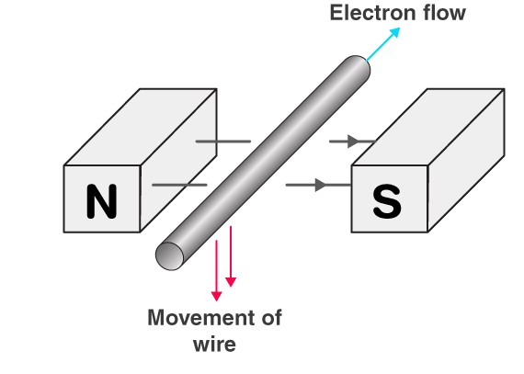

Slide 19
The induced electromotive force with different polarities induces a current whose magnetic field opposes the change in magnetic flux through the loop in order to ensure that the original flux is maintained through the loop when current flows in it
Lenz’s Law is part of Faraday’s Law and can help you determine the direction of the current provided you know HOW the flux is changing

Slide 20
Application
Eddy current balances
Metal detectors
Eddy current dynamometers
Braking systems on train
AC generators
Card readers
Microphones

Slide 21
Electromagnetic Induction Useful Applications
AC Generators use Faraday’s law to produce rotation and thus convert electrical and magnetic energy into rotational kinetic energy.
This idea can be used to run all kinds of motors. Since the current in the coil is AC, it is turning on and off thus creating a CHANGING magnetic field of its own. Its own magnetic field interferes with the shown magnetic field to produce rotation.

Slide 22
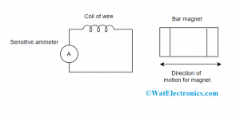
Faraday’s Law Derivation

Slide 23
the magnitude of the induced emf in the conductor is equal to the rate of change of magnetic flux linked to the conductor
electromagnetic induction, the EMF induced in the conductor is equal to the rate of change of flux linkage

Slide 24
Eddy Current
Eddy currents are loops of electrical current induced within conductors by a changing magnetic field in the conductor according to Faraday’s law of induction. Eddy currents flow in closed loops within conductors, in planes perpendicular to the magnetic field.

Slide 25
Induced electromotive force is produced in the coil when there is a change in the magnetic flux linked with that coil. Eddy currents are named so because the current looks like eddies or whirlpools. When a conductor is placed in the changing magnetic field, the induced current in the conductor is termed as Eddy current

Slide 26
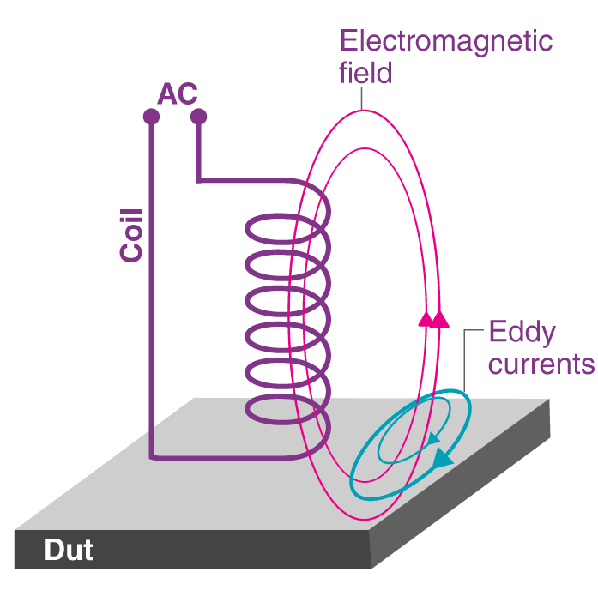

Slide 27
Dynamo
A dynamo is an electrical generator that utilizes a commutator to generate direct current.
Dynamo is a device that converts mechanical energy into electrical energy.
Dynamos were the first electrical generators utilized just to supply power to industry, as well as they served as the platform for several subsequent electric-power conversion types of equipment, such as the alternating-current (AC) alternator, electric motor, as well as a rotary converter.

Slide 28
Working of Dynamo:
The image below shows a basic dynamo with such a coil constructed of conducting wires that are positioned between the North pole and South pole of two permanent magnets.
Whenever the coil is to be motionless, no voltage is produced. The magnetic field changes as the coil spins, causing a voltage to be generated within the coil.

Slide 29
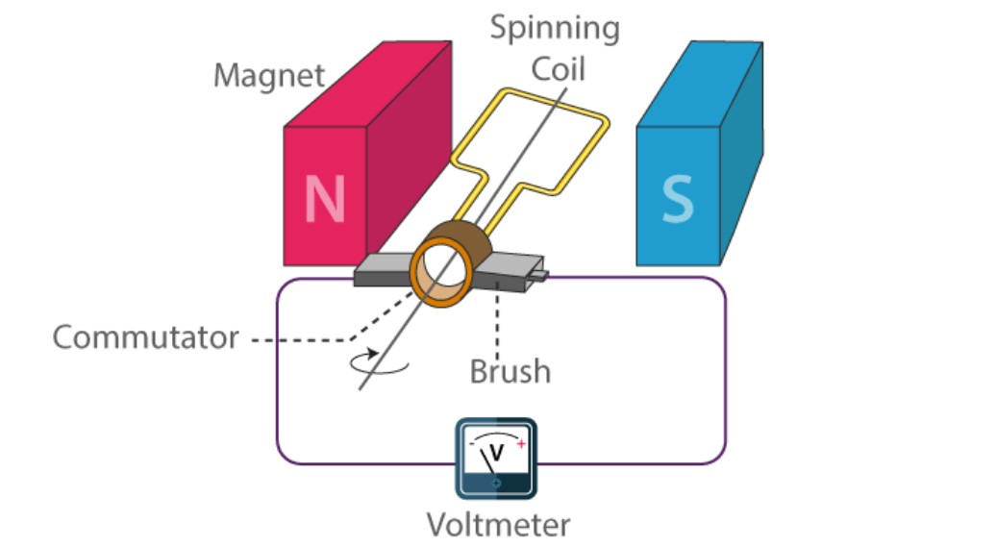

Slide 30
The left side of the coil travels from the North pole of such a left magnet during the first half of the revolution. The coil travels from the South pole of the right magnet throughout the second part of the revolution.
There are two conceivable polarities throughout these rounds:
Positive
Negative
An alternating voltage is a difference between their polarities.

Slide 31
Inductive resistance
Inductive reactance, generally reactance, is the resistance of an inductive circuit.
It is termed reactance since it fluctuates slightly from the resistance provided through any equipment or gadget. It is denoted by “
”.
The SI unit of inductive resistance is Ohm

Slide 32
